Slide 1
Youth Protection Certification
Why is it important?
Requirements overview
Process overview
Issues to be addressed
Your role as a District Deputy

Slide 2
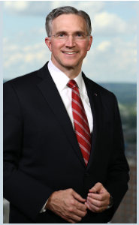
1 – Why is it important?
Ensuring a safe environment for the children, young people and other vulnerable persons we serve is a crucial obligation for Knights of Columbus leaders. Upholding the Order’s high standards of protection can establish you as a positive role model to members, their families and others. Likewise, neglect — even that which is unintentional — can undermine our mission. Only those members who have shown a clear commitment to living out the highest Christian ethical and moral standards and personal integrity in their day-to-day personal lives and work may be considered for selection as key leaders.
Notes:
Audio Overview
These 9 things should be your main focus as you begin
Have these done by end of September (Q1)
These are the most important things to get you started
If you handle these first, the rest is much easier
If you miss 1 or more of these, your job gets a lot harder

Slide 3
2 – Requirements Overview
Email Addresses are mandatory
They must also be unique to the member
There must be a Grand Knight (via form 185)
There must be a form 365 naming 3 different people as…
Program Director
Community Director
Family Director
All 4 roles must complete the Safe Environment Training
Community & Family Directors must also consent to a background check
state-leader-compliance-guide-2021-2022.pdf (kofc.org)
Notes:
Audio Overview
These 9 things should be your main focus as you begin
Have these done by end of September (Q1)
These are the most important things to get you started
If you handle these first, the rest is much easier
If you miss 1 or more of these, your job gets a lot harder

Slide 4
3. Process Overview
Council submits forms 185/365
Supreme notifies Praesidium
Praesidium sends e-mail to members for training
Council is compliant & certified
Praesidium notifies Supreme
Member signs in, takes training & submits background information
Certification (and Background check) is valid for 3 years (36 months)
Notes:
Audio Overview
These 9 things should be your main focus as you begin
Have these done by end of September (Q1)
These are the most important things to get you started
If you handle these first, the rest is much easier
If you miss 1 or more of these, your job gets a lot harder

Slide 5
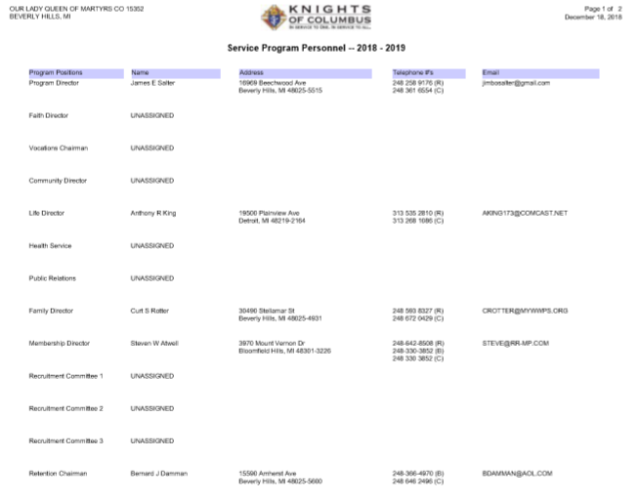
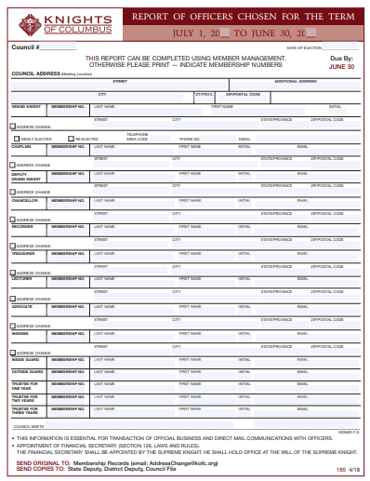
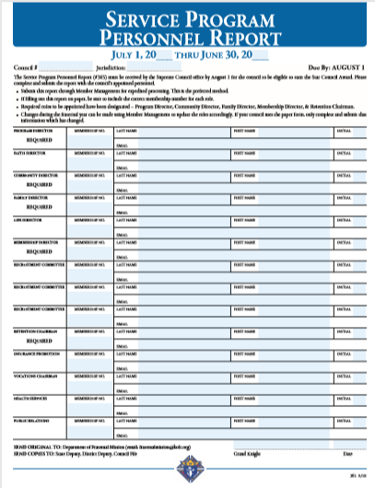
4 Issue #1 – Forms not submitted or incomplete
If form 185/365 is not submitted…
The council does not have a Grand Knight
The council does not have a Program Director
The council does not have a Community Director
The council does not have a Family Director
Solution
Ensure these forms are submitted
Ensure form 365 names a Program, Community and Family Director
Video instructions for forms 185 & 365 in Member Management
Notes:
Audio Overview
These 9 things should be your main focus as you begin
Have these done by end of September (Q1)
These are the most important things to get you started
If you handle these first, the rest is much easier
If you miss 1 or more of these, your job gets a lot harder

Slide 6
4 Issue #2 – People removed for non-compliance
When someone is named as a Program Director
Week 1 – They get an email asking them to take their classes (Pending Status)
Week 6 – They will be marked as non-compliant
Week 7 – They will be removed from their position
Solution
Keep an eye on the reports
Talk to GK & Directors at council meetings (1-on-1)
Weeks 1-4 – Remind the Grand Knight of “Pending” people
Weeks 5-7 – Call the Director yourself
Many times they don’t even know they were assigned the role
Many times they refuse to do it (tell the GK to name someone else)
Many times they forgot so the reminder is very helpful
Many times they need help (computer challenged)
Notes:
Audio Overview
These 9 things should be your main focus as you begin
Have these done by end of September (Q1)
These are the most important things to get you started
If you handle these first, the rest is much easier
If you miss 1 or more of these, your job gets a lot harder

Slide 7
4 Issue #3 – I never received notification
I’ve heard them all
The emails may go to their spam folder
Their looking for an email from Supreme (It’s from Armatus Support)
The email address on file in MM is wrong
They just missed it
It’s just an excuse (for some people, it’s never their fault)
Some people have email blockers & won’t let unknown emails through
Solution
Contact Supreme @ 203-800-4940 or OYP@kofc.org
Provide name, council # & member #
They will resend him (and you) his information within 24 hours
Note: Always request Supreme copies you on the email so when the person (once again) says he never got anything, you have proof it was sent.
Notes:
Audio Overview
These 9 things should be your main focus as you begin
Have these done by end of September (Q1)
These are the most important things to get you started
If you handle these first, the rest is much easier
If you miss 1 or more of these, your job gets a lot harder

Slide 8
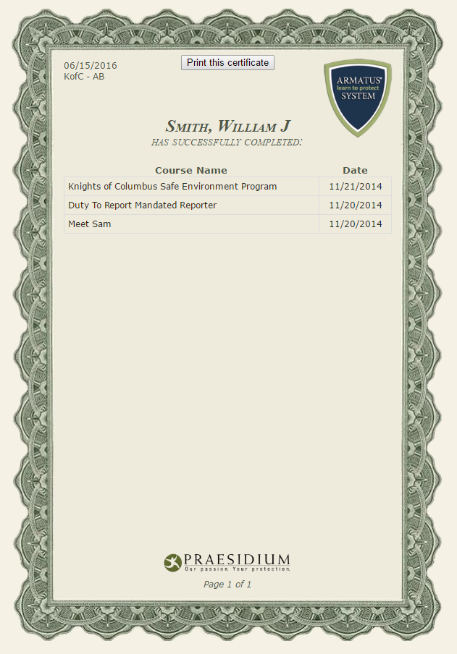
4 Issue #4 – Director says he’s compliant
Reasons
Maybe timing (reports are done weekly)
Maybe took classes but didn’t do background check (or vise-versa)
Maybe took 1 class but not all classes
Maybe didn’t use user ID and password sent to them
Solution
GK, PD & Terry Carl have access to “instantaneous” reports from Praesidium (watch this video – All Officers - Youth Protection Overview Video 20.06)
Call Supreme @ 203-800-4940 – They’ll give you the facts
Ask him for a copy of his certificate
Does it say “Self-volunteer” or “list his council #
Does it show ALL classes required
Notes:
Audio Overview
These 9 things should be your main focus as you begin
Have these done by end of September (Q1)
These are the most important things to get you started
If you handle these first, the rest is much easier
If you miss 1 or more of these, your job gets a lot harder

Slide 9
4 Issue #5 – Refuse to comply
Excuse | Response
Our council doesn’t do youth programs | Youth do attend Knights programs with their families It’s mandatory - regardless
I’m insulted the Knights don’t trust me | Priests, Bishops, etc… do this. You can to. It’s not a matter of trust. It’s the right thing to do.
They have something to hide | Dah!!! This is why we do this.
Child abuse doesn’t happen in my council | It happens. Let’s be prepared just in case.
It’s a waste of time | 2 hours to learn & be prepared is not a big deal Child abuse IS a big deal
I already do my Diocesan youth protection – The Knights youth protection is a duplication of effort. | 10%-30% of the training is “the same”. So… just skip the stuff you already know. Just hit next page!!!
Note: If they still don’t want to do it, don’t push them.
Tell the GK to name someone else to this position
Notes:
Audio Overview
These 9 things should be your main focus as you begin
Have these done by end of September (Q1)
These are the most important things to get you started
If you handle these first, the rest is much easier
If you miss 1 or more of these, your job gets a lot harder

Slide 10
4 Issue #6 – No one will volunteer
You only need 3 people
The Grand Knight can fill 2 roles
The Deputy Grand Knight will eventually need to be compliant. Starting early doesn’t hurt
Are there District Deputies, Diocesan Directors, State Directors in their council? They can/should volunteer.
Priests can fill these roles (and don’t need to take the certification)
Come on… You really can’t find one person willing to spend 2 hours to learn about youth protection???
Notes:
Audio Overview
These 9 things should be your main focus as you begin
Have these done by end of September (Q1)
These are the most important things to get you started
If you handle these first, the rest is much easier
If you miss 1 or more of these, your job gets a lot harder

Slide 11
5 Your role as a District Deputy
Remind any/all non-compliant councils at every meeting
Don’t do it “during the meeting” – catch people before or after
Get commitment they will comply
Be reasonable – Let people with valid excuses have “some time”
Be a positive force to support Youth Protection
If they see you see it as important, they will see it as important
Take the classes yourself – Understand (first hand) how hard/easy this is.
Offer to help
If you just beat them up, you’ll never win them over
Listen to their issues & work with Terry Carl to address their issues
Notes:
Audio Overview
These 9 things should be your main focus as you begin
Have these done by end of September (Q1)
These are the most important things to get you started
If you handle these first, the rest is much easier
If you miss 1 or more of these, your job gets a lot harder

